Slide 1
Greedy Method

Slide 2
Contents
Greedy Method
Greedy Graph Algorithms
Kruskal’s Algorithm
Dijkstra’s Algorithm

Slide 3
What is Greedy Method?
One of the Algorithm Design method.
Question :Find the shortest path from A to E using Greedy method.
vertex
edge
weight of the edge
4
A
B
5
3
4
E
2
1
3
C
2
D
Greedy method: Makes the choice that looks best at the moment

Slide 4
Solution
Step 1
4
Lowest path
cost is 2
A
B
5
3
4
E
2
1
3
C
2
D
Step 2
4
A
B
5
3
4
E
2
1
2
3
C
D
Lowest path cost is 2

Slide 5
Step 3
4
A
B
5
3
4
E
2
1
2
3
C
D
Lowest path cost is 1
Step 4
4
Lowest path cost is 5
A
B
5
3
4
E
2
1
2
3
C
D

Slide 6
Final Result is:
4
A
B
5
3
4
E
2
1
2
3
C
D
Order of visit is A→ C → D → B→ E path cost is 2+2+1+5 = 10

Slide 7
Greedy Method(contd.)
Greedy method makes the choice that looks best at the moment
Makes locally optimal choice hoping that it will lead to globally optimal solution.
Do not always yield optimal(best we can achieve) solutions
Powerful and works well for many problems.
Does the previous example yield optimal solution?

Slide 8
Optimal Solution
4
A
B
5
3
4
E
2
1
3
C
2
D
Here the optimal solution is A →D →E path cost is 3+3 = 6 and it is the minimum value
Greedy method solution is A→ C → D → B→ E path cost is 2+2+1+5 = 10
Greedy method does not yield optimal solution in always.

Slide 9
What is a Spanning Tree?
Tree : A connected undirected graph that contains no cycles is called a tree.
Spanning Tree : A spanning tree of a graph G is a subgraph of G that is a tree and contains all the vertices of G.
A
B
A
B
A
B
C
C
C
D
D
D
E
E
E
Undirected Graph
some Spanning Trees

Slide 10
Properties of spanning Tree
The spanning tree of a n –vertex undirected graph has exactly n-1 edges.
Spanning tree has no cycles
It Connects all vertexes in the graph.
Input: A connected, undirected graph G = (V, E)
with weight function w : E → R.
Output: A spanning tree T —a tree that connects
all vertices — of minimum weight:
A
B
C
cycle
D
E

Slide 11
What is a Minimum Cost Spanning Tree?
Minimum Cost Spanning Tree(MCST) is the tree amongst all spanning trees with the smallest cost
6
A
B
A
B
1
1
1
1
3
C
2
3
C
2
4
D
D
E
5
E
Weighted Undirected Graph
Minimum Cost Spanning Tree

Slide 12
Where do we use MCST?
Computer Networks
Minimum spanning trees are useful in constructing networks, by describing the way to connect a set of sites using the smallest total amount of wire.
Ship/ Aero plane lines
We can connect all the cities using the MCST and using MCST, will reduce amount of cost & time to travel.
In the design of electronic circuitry
It is often necessary to make the pins of several components electrically equivalent by wiring them together. To interconnect a set of n pins, we can use an arrangement of n - 1 wires, each connecting two pins. Of all such arrangements, the one that uses the least amount of wire is usually the most desirable

Slide 13
Growing Tree with the greedy method
INPUT: Connected weighted graph G
While no more edges
Take edge of least weight
If it will not make a cycle in T, add it to T
OUTPUT: T

Slide 14
Greedy Algorithms
1. Kruskal’s algorithm

Slide 15
Kruskal’s algorithm
Input: An undirected graph G(V,E) with a cost function c on the edges
Output: T the minimum cost spanning tree for G
MST-KRUSKAL(G, w)
1 A = Ø
2 for each vertex v ∈ G.V
3 MAKE-SET (v)
4 sort the edges of E into non decreasing order by weight w
5 for each edge (u, v) ∈ E, taken in non decreasing order by weight
6 if FIND-SET (u) ≠ FIND-SET (v)
7 A = A ∈ {(u, v)}
8 UNION(u, v)
9 return A

Slide 16
Kruskal’s algorithm (Contd.)
Line 1 - 3 : Initialize the set A to empty set and create |V| trees, one containing each vertex ( MAKE-SET (v) )
Line 5 - 7 : Examine edges in order of weight, from lowest to highest.
For each edge (u,v) it checks whether the endpoints u and v belong to the same tree ( FIND-SET (u) and FIND-SET (v) ) .
If so it creates a cycle and cannot be added .
If not Line 7 adds the edge (u,v) to A.
Line 8 : Merges the vertices ( UNION (u, v) )

Slide 17
Question
Find the Minimum Cost Spanning Tree (MCST) of this Graph using Kruskal’s algorithm
A
3
3
F
1
B
2
2
4
6
E
5
1
C
D

Slide 18
Solution
A
3
3
F
1
B
2
2
4
6
{A} {B} {C} {D} {E} {F}
1 (A,D)
1 (C,D)
2 (C,F)
2 (E,F)
3 (A,F)
3 (A,B)
4 (B,E)
5 (D,E)
6 (B,C)
merge
{A,D} {B} {C} {E} {F}
E
5
1
C
merge
{A,C,D} {B} {E} {F}
D
merge
{A,C,D,F} {B} {E}
A
merge
{A,C,D,E,F} {B}
F
B
reject
{A,C,D,E,F} {B}
merge
{A,C,D,E,F,B}
reject
{A,C,D,E,F,B}
C
reject
{A,C,D,E,F,B}
E
D
reject
{A,C,D,E,F,B}

Slide 19
Kruskal’s algorithm(contd.)
Each vertex is labeled as being in a set
Initially each is in it’s own set
Each set of vertices forms a MCST for the subgraph it connects
It is safe to join two vertices from different sets
The edge that joins the sets goes into T
Note that Kruskal’s algorithm is greedy:
Just adds a shortest edge at the moment without worrying about the overall structure
MCST resulting from this algorithm is optimal

Slide 20
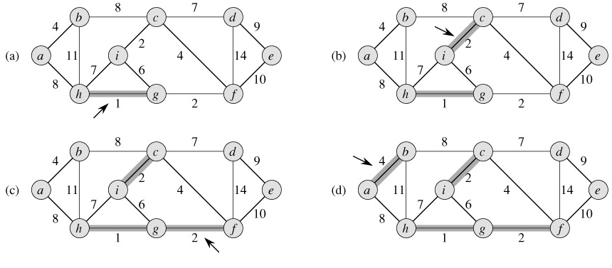
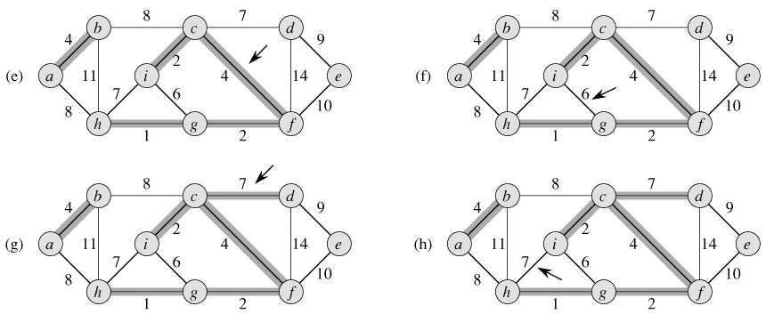
Example- Kruskal’s algorithm

Slide 21
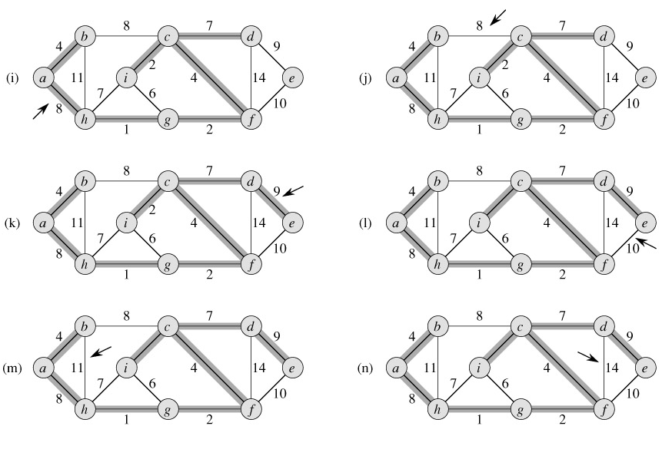
Example (Contd.)

Slide 22
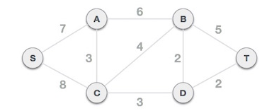
Question
Find the Minimum Cost Spanning Tree (MCST) using Kruskal’s algorithm

Slide 23
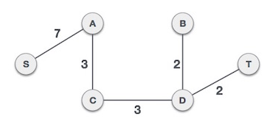
Solution

Slide 24
Greedy Algorithms
2. Dijkstra’s algorithm

Slide 25
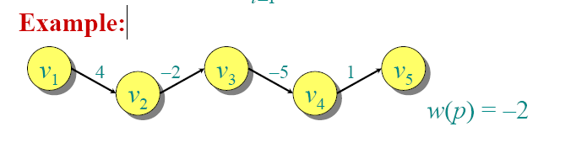
Dijkstra’s Single-source shortest path
Introduce in 1959
Provides the most efficient algorithm for solving shortest-path problem.

Slide 26
Shortest Paths
A motorist wishes to find the shortest possible route from Badulla to Matara. Given the map of Sri lanka, on which the distance between each pair of cities is marked, how can we determine the shortest route?
Monaragala
30
35
Kataragama
Badulla
110
30
80
Matara
90
90
28
72
Galle
Colombo

Slide 27
Shortest Paths
v0
w₁
v1
w₂
v2
w_{k}
vk
In a shortest-paths problem, we are given a weighted, directed graph G = (V,E), with weights assigned to each edge in the graph.
The weight of the path p = (v₀, v₁, v₂, …, v_{k}) is the sum of the weights of its constituent edges:
v₀ → v₁ → v₂ . . . → v_{k-1}→ v_{k}

Slide 28
The single-source shortest paths problem
Given G (V,E), find the shortest path from a given source vertex s ∈ V to every vertex v ∈ V.
For each vertex v ∈ V in the weighted directed graph, v.d represents the distance from s to v.
Initially, s.d = 0
v1.d = ∞
v2.d = ∞
Dijkstra's Algorithm : At every step of the algorithm, we compute,
v2.d = min {v2.d, v1.d + w2}
Ex: if , w1 = 2 and w2 = 4 then,
v1.d = 0 +2 = 2
v2.d = 2 + 4 = 6
Dijkstra's algorithm is based on the greedy principle because at every step we pick the path of least cost.
v2.d
v1.d
v2
0
w2
s
w1
v1

Slide 29
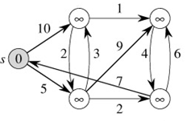
Dijkstra’s algorithm
v.d = ∞
First we initialize the shortest-path estimates and predecessors by the following procedure.
INITIALIZE-SINGLE-SOURCE(G, s)
1 for each vertex v ∈ G.V
2 v.d = ∞
3 v.π = NIL
4 s.d = 0
v.π is the predecessor of vertex v
v.d is the shortest-path estimate. i.e upper bound on the weight of the shortest path from source s to v.
s.d is starting path estimate
After initialization,
v.π = NIL for all v ∈ V, s.d = 0, and v.d = ∞ for v ∈ V - {s}.
weight
s.d = 0
v.d = ∞

Slide 30
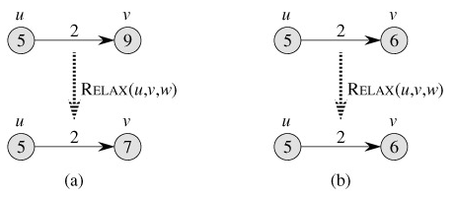
Dijkstra’s algorithm
The process of relaxing an edge (u, v) consists of testing whether we can improve the shortest path to v found so far by going through u and, if so, updating v.d and v.π. A relaxation step may decrease the value of the shortest-path estimate v.d and update v's predecessor v.π.
RELAX(u, v, w)
1 if v.d > u.d + w(u, v)
2 v.d = u.d + w(u, v)
3 v.π = u
Relaxation of an edge (u, v) with weight w(u, v) = 2.
Because v.d > u.d + w(u, v) prior to relaxation, the value of v.d decreases to 7 .
(b) Here, v.d ≤ u.d + w(u, v) before the relaxation step, and so v.d is unchanged by relaxation.

Slide 31
Dijkstra's Single-source shortest path
Input: G =(V,E), the weighted directed graph and u the source vertex
Output: for each vertex, v, v.d is the length of the shortest path from u to v.
Dijkstra's algorithm maintains a set S of vertices whose final shortest-path weights from the source s have already been determined. The algorithm repeatedly selects the vertex u ∈ V - S with the minimum shortest-path estimate, adds u to S, and relaxes all edges leaving u. In the following implementation, we use a min-priority queue Q of vertices, keyed by their d values.
DIJKSTRA(G, w, s)
1 INITIALIZE-SINGLE-SOURCE(G, s)
2 S = Ø
3 Q = G.V
4 while Q ≠ Ø
5 u = EXTRACT-MIN(Q)
6 S = S ∈ {u}
7 for each vertex v ∈ G.Adj[u]
8 RELAX(u, v, w)

Slide 32
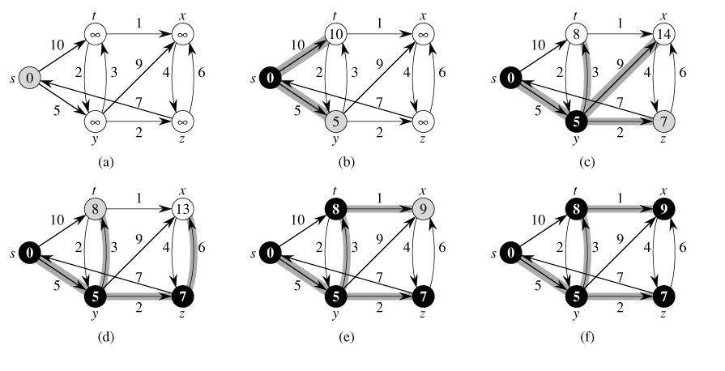
The shortest-path estimates are shown within the vertices, and shaded edges indicate predecessor values. Black vertices are in the set S, and white vertices are in the min-priority queue Q = V - S. (a) The situation just before the first iteration of the while loop of lines 4-8. The shaded vertex has the minimum d value and is chosen as vertex u in line 5. (b)-(f) The situation after each successive iteration of the while loop. The shaded vertex in each part is chosen as vertex u in line 5 of the next iteration. The d and π values shown in part (f) are the final values.
The execution of Dijkstra's algorithm.
source

Slide 33
Example
1
u
5
b
a
2
9
3
4
d
2
e
c
9
4
1
2
3
f
h
g
Find the shortest path from u to all the vertexes.

Slide 34
Step Vertex to Distance to vertex Unmarked
# be marked vertices
u.d a.d b.d c.d d.d e.d f.d g.d h.d
0 u 0 1 5 ∞ 9 ∞ ∞ ∞ ∞ a,b,c,d,e,f,g,h
1 a 0 1 5 3 9 ∞ ∞ ∞ ∞ b,c,d,e,f,g,h
2 c 0 1 5 3 7 ∞ 12 ∞ ∞ b,d,e,f,g,h
3 b 0 1 5 3 7 8 12 ∞ ∞ d,e,f,g,h
4 d 0 1 5 3 7 8 12 11 ∞ e,f,g,h
5 e 0 1 5 3 7 8 12 11 9 f,g,h
6 h 0 1 5 3 7 8 12 11 9 f,g
7 g 0 1 5 3 7 8 12 11 9 f
8 f 0 1 5 3 7 8 12 11 9 --------
u
b
a
1
5
2
9
3
c
4
2
e
d
9
1
2
4
f
3
h
g

Slide 35
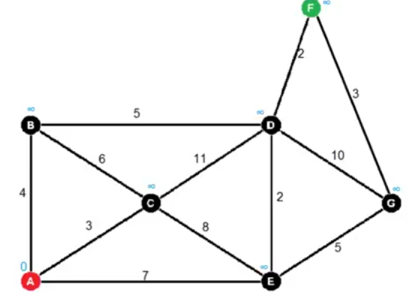
Question
Find the shortest distance from A to F using Dijkstra’s algorithm
Shortest distance is 11 (A → B → D → F)

Slide 36
References
T.H. Cormen, C.E. Leiserson, R.L. Rivest, Clifford Stein Introduction to Algorithms,3rd Edition, MIT Press, 2009

